Slide 1
AIRCRAFT instruments

Slide 2
Instruments classification
Flight instruments
To control Aircraft’s flight attitude
Engine Instruments
To measure operating parameters of the Aircraft’s engine(s)
Navigation Instruments
To guide Aircraft along a course

Slide 3
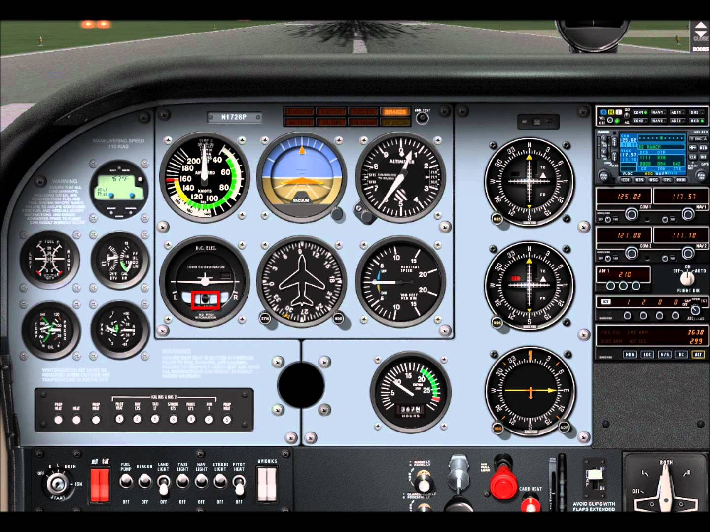
Flight Instruments

Slide 4
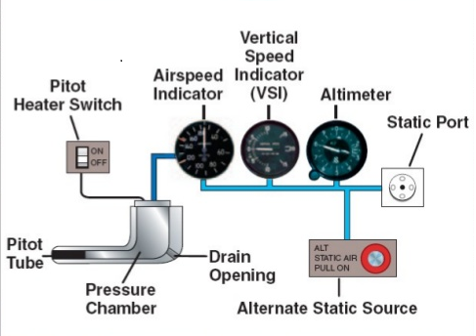
Flight Instruments
Pitot-Static System Based Instruments
Airspeed Indicator
Altimeter
Vertical Speed Indicator
Gyro Based Instruments
Attitude Indicator
Heading Indicator
Turn Coordinator

Slide 5
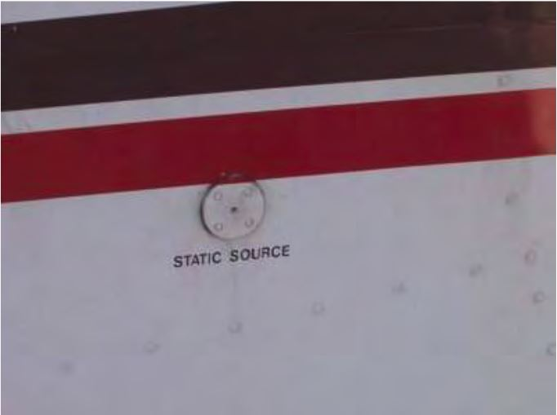
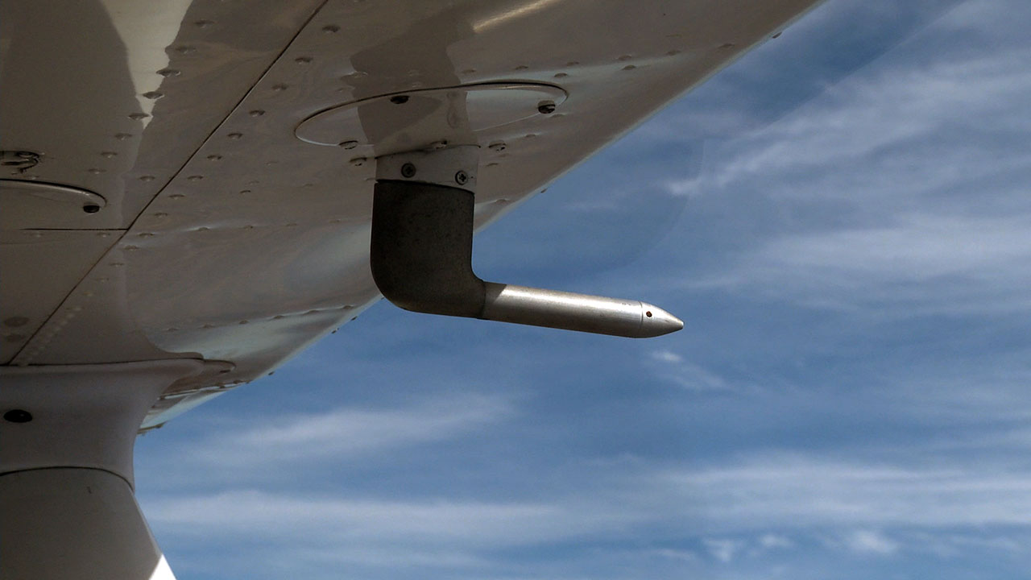
Pitot-Static System
The Pitot-Static system of an aircraft is a system in which total pressure created by the forward motion of the aircraft and static pressure of the atmosphere surrounding it are sensed and measured in terms of speed, altitude and rate of change of altitude
Static Port
Pitot tube

Slide 6
Pitot-Static System
Airspeed Indicator Inputs
Ram pressure (Pitot tube): Pressure exerted on a body which is moving through a fluid medium (comes from pitot tube)
Static pressure: Atmospheric pressure outside the aircraft (comes from static port)
Altimeter
Static pressure
Vertical Speed Indicator
Static pressure

Slide 7
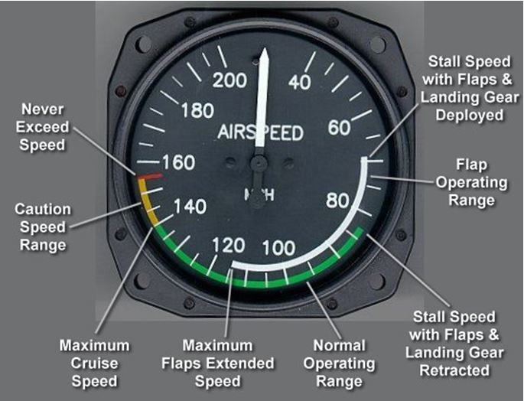
Airspeed indicator

Slide 8
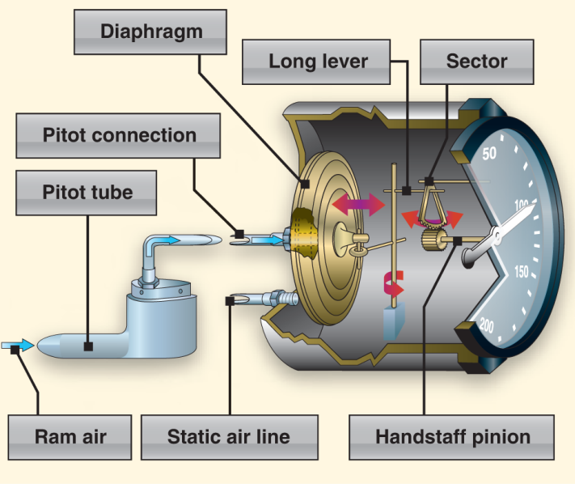
Airspeed indicator
Uses ram air from the pitot tube as well as static air.
Ram (static + dynamic) air pushes against a diaphragm inside the airspeed indicator, which will then be able to expand or contract accordingly. This movement of the diaphragm is then translated in to needle movement.

Slide 9
Airspeed indicator
Types Of Airspeeds
Calibrated(CAS):
Speed corrected for installation and instrument errors.
This will give actual speed in which aircraft is moving.
CAS is equal to TAS in standard atmosphere at sea level.
True(TAS):
It is equivalent to CAS corrected for non standard temperature and pressure.
For a given CAS, TAS increases as altitude increases.
Equivalent(EAS):
The airspeed after it is calibrated for compressibility.
Indicated(IAS):
IAS is the direct airspeed reading shown by an airspeed indicator.
The reading has not been corrected for installation error, and other errors.
As height increases, IAS falls below the true airspeed.

Slide 10
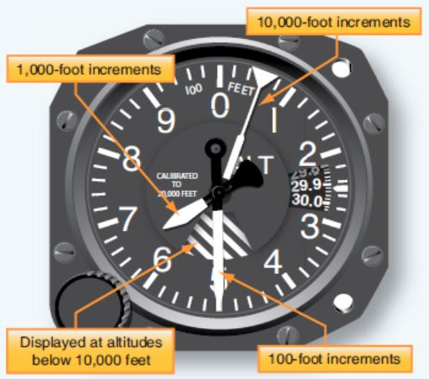
altimeter
The altimeter shows the aircraft’s altitude above sea-level by measuring the difference between the pressure in a stack of aneroid capsules inside the altimeter and the atmospheric pressure obtained through the static system.

Slide 11
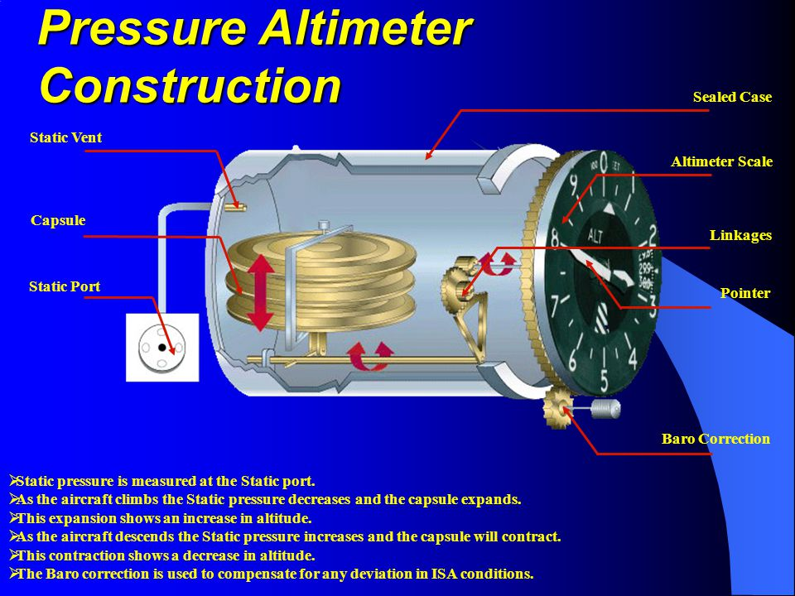

Slide 12
altimeter
Altimeter shows the vertical distance between the altitude equivalent to current pressure altitude ad a reference pressure altitude.
The reference pressure altitude is set in pressure units (hPa or Hg) on altimeter subscale. This is known as the ‘’altimeter setting’’.
Pressure altimeter operates on the principle that average atmospheric pressure deceases linearly with altitude.
The instrument is enclosed in a case that is connected to the outside of the aircraft by an air pressure inlet at the rear of the housing.
Two or more aneroid capsules are positioned near the inlet (from which air has been exhausted).
Capsules expand when outside air pressure falls (as in climbing) and contract when outside air pressure rises.
By a mechanical arrangement, the contraction and expansion of the aneroid capsules is converted to the movement of pointers on a dial.

Slide 13
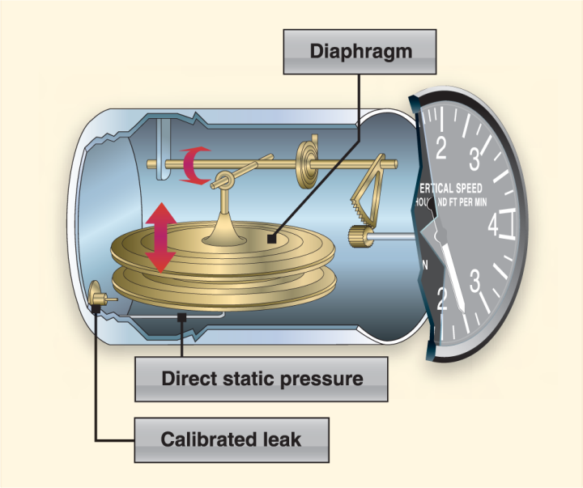
Vertical speed indicator
VSI indicates the rate of climb or descent of the aircraft. It is a very sensitive differential pressure instrument.
VSI is also called as rate of climb indicator or variometer.
The internal components of VSI consist of a diaphragm, calibrated leak orifice, and mechanical linkage.

Slide 14
Vertical speed indicator
Unrestricted air from the static line enters directly into the diaphragm, while static air enters the air tight casing through the calibrated leak.
If the aircraft were in level flight or on the ground this pressure would be equal.
As aircraft climb or descends the pressure inside the diaphragm changes immediately. The case however does not; because of the calibrated leak, the pressure inside the casing will remain higher or lower for a period of time.
This difference in pressure allows the diaphragm to expand and contract and through mechanical linkage is shown as either climb or descent on the instrument face.

Slide 15
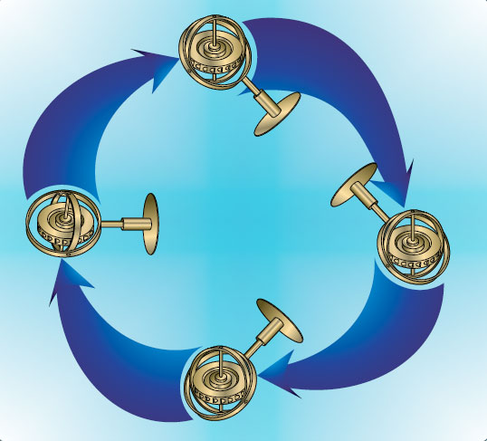
Gyro Based instruments
Gyroscopic Principles
Rigidity in space: A gyroscope remains in a fixed position in the plane in which it is spinning. By mounting a set of gimbal rings, the gyro is able to rotate freely in any direction. If gimbal rings are tilted, the gyro remain in the plane in which it was originally spinning.

Slide 16
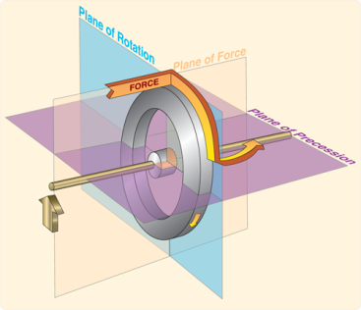
Gyro Based instruments
Precession: It is the tilting or turning of a gyro in response to a deflective force. The reaction to this force does not occur at the point at which it is applied; rather, it occurs at a point that is 90deg later in the direction of rotation.
Precession can also create some minor errors in some instruments.

Slide 17
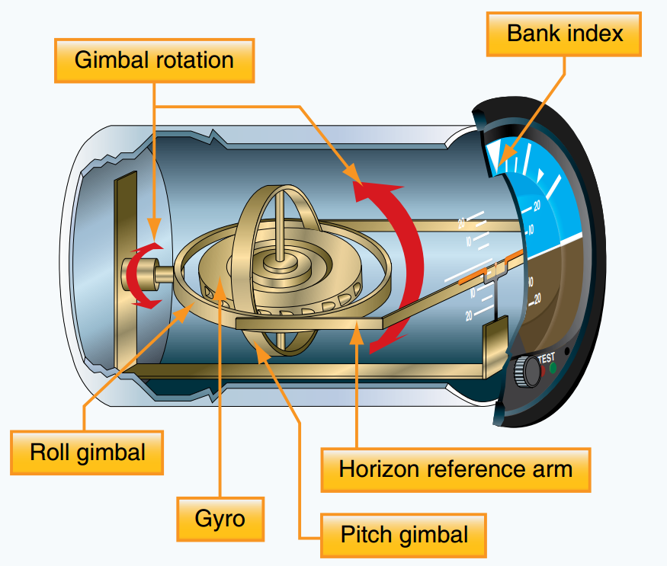
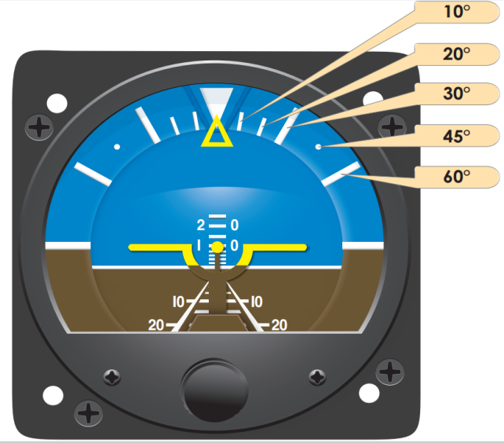
Attitude indicator
Attitude indicator also called as artificial horizon.
It informs the pilot of the aircraft orientation relative to Earth’s horizon, and gives an immediate indication of the smallest orientation change.
The gyro mounted in the attitude indicator rotates in the horizontal plane and maintains its orientation relative to the real horizon as the airplane banks, climbs, and descends.

Slide 18
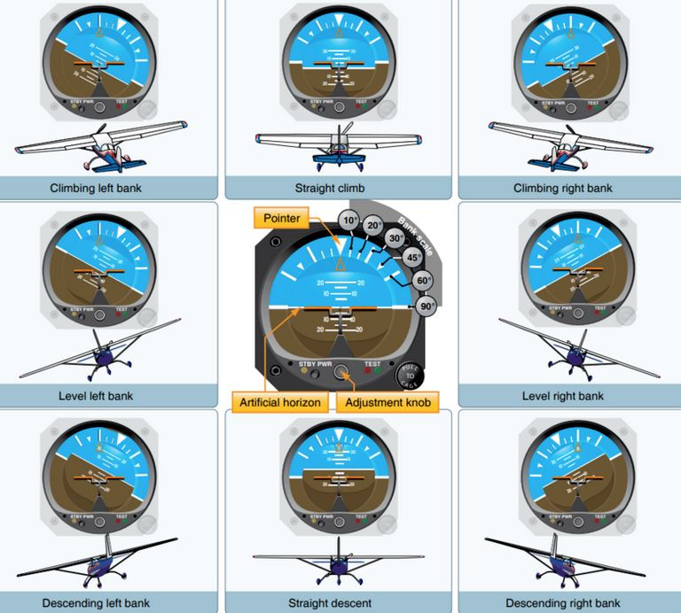
Attitude indicator

Slide 19
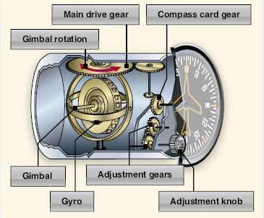
Heading indicator
The operation of heading indicator depends upon the principle of rigidity in space.
The rotor turns in a vertical plane and fixed to the rotor is a compass card. Since, the rotor remains rigid in space, the points on the card hold the same position in space relative to the vertical plane of gyro.
As the instrument case and the aircraft revolve around the vertical axis of the gyro, the
card provides clear and
accurate heading
information.

Slide 20
Turn indicators
Turn and slip indicator
It shows only the rate of turns in degrees per second.
The gyro rotates in vertical plane, corresponding to aircraft’s longitudinal axis.
A single gimbal limits the planes , in which the gyro can tilt, and a spring tries to return it to the center.
Because of precession, a yawing force causes the gyro to tilt left or right. The turn and slip indicator uses a pointer to show the direction and rate of turn.
Turn Coordinator
It is mounted at an angle so it can initially show roll rate. When the roll stabilizes, it indicates rate of turn.

Slide 21
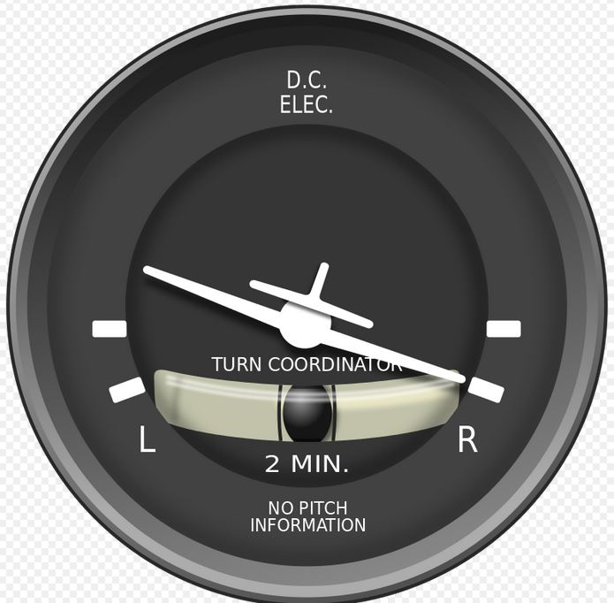
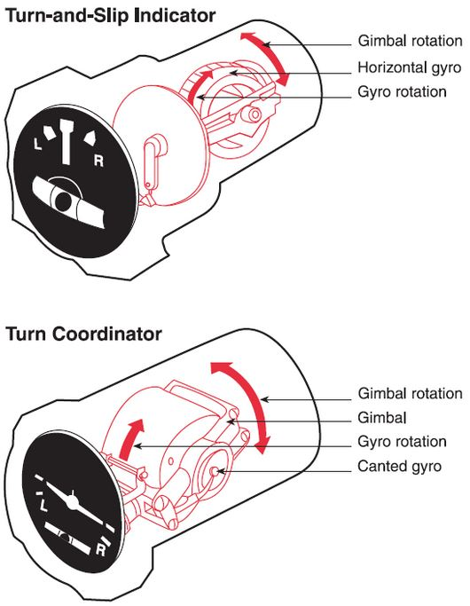
Turn indicators

Slide 22
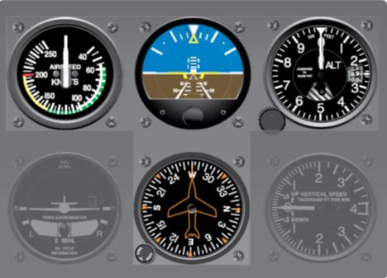
T-arrangement
Most aircrafts have flight instruments in a standardized pattern called the ‘’T’’ arrangement.
The attitude indicator is in the top center
Airspeed to the left, altimeter to the right, and
Heading indicator under the attitude indicator.

Slide 23
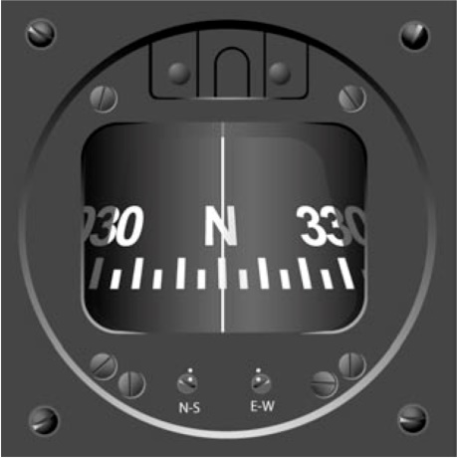
Magnetic compass
The magnets of the magnetic compass align with the Earth’s magnetic field and the pilot reads the direction on the scale opposite the lubber line (the mid-line in the indicator).
A compensator assembly mounted on the top or bottom of the compass allows an aviation maintenance technician to create a magnetic field inside the compass housing that cancels the influence of local outside magnetic fields.
White line in the middle is lubber line

Slide 24
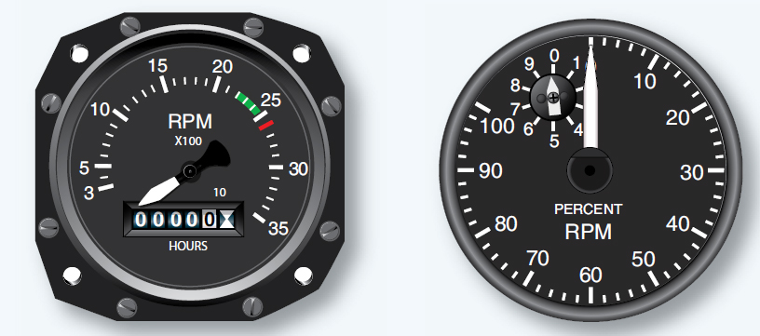
Tachometer
Tachometer or RPM gauge is an instrument measuring the rotation speed of a shaft or disk of the engine.
On reciprocating engines, the tachometer is used to monitor engine power and to ensure the engine is operated within certified limits.
In gas turbine engines, they are used to monitor the speed(s) of the compressor section of the engine.
In reciprocating engine In turbine engine

Slide 25
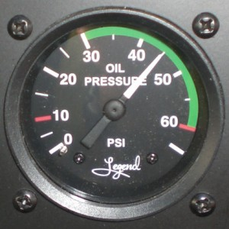
Oil pressure indicator
This is the primary indicator that all is well with the engine.
A cold engine will always shows a very high oil pressure.
Once hot, the pressure should remain in the green arc under normal RPMs.
A low pressure may indicate a serious problem with the oil.

Slide 26
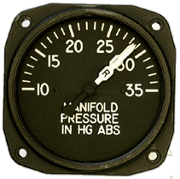
Manifold pressure
Manifold pressure gauge is equipped with the same diaphragm used in altimeters and air speed indicators and measures the absolute pressure of the fuel/air mixture inside the intake manifold.
Manifold pressure is one of the factors required to obtain the correct power setting of the aircraft engine.

Slide 27
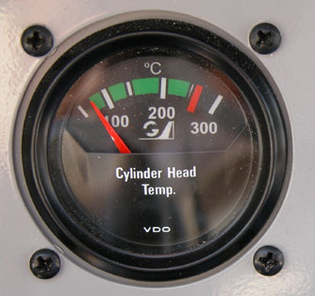
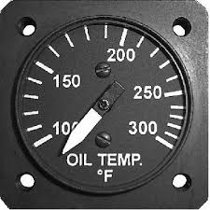
Cylinder head temperature and oil temperature gauge
Cylinder head temperature gauge measures the cylinder head temperature of an engine. If temperature climbs towards the red line it may indicate a serious problem.
The oil temperature gauge is very important device for monitoring the wellbeing of the engine. High power should not be used until the temperature has climbed in to the operating range.

Slide 28
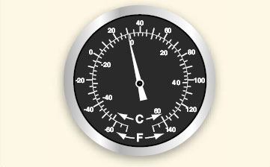
Outside air temperature(oat)
The outside air temperature gauge is a simple and effective device mounted so that the sensing element is exposed to the outside air.
The sensing element consists of a bi-metallic type thermometer in which two dissimilar materials are welded together in a single strip and twisted in to a helix.

Slide 29
Vacuum gauge
Vacuum is a differential pressure indication, measuring the pressure to be measured is compared to atmospheric pressure through the use of a sealed diaphragm or capsule.
Gyro pressure gauge, vacuum gauge, or suction gauge are all terms for the same gauge used to monitor the vacuum developed in the system that actuates the air driven gyroscopic flight instruments
Air is pulled through the instrument, causing gyroscopes to spin.
The speed at which the gyros spin needs to be within a certain range for correct operation.

Slide 30
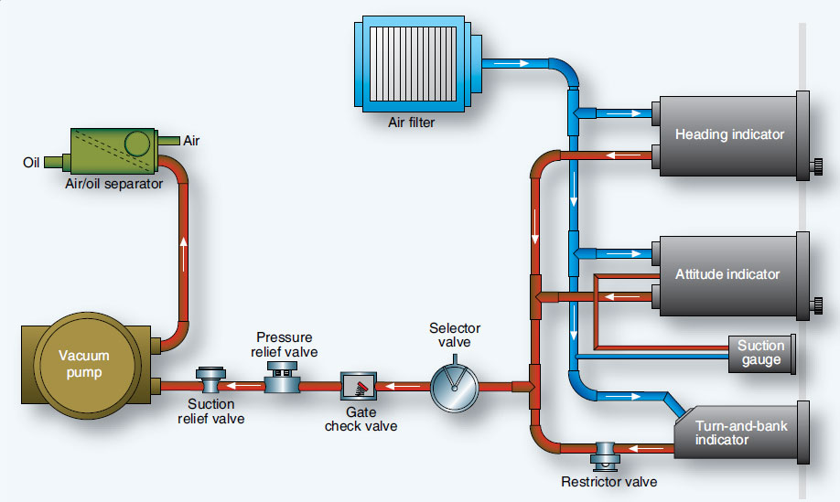

Slide 31
Navigation instruments
Position information
The basis of all navigation outputs is position.
Position can be given in geographic coordinates, geodetic latitude and altitude
Steering information
Due to crowding of the airspace, major tasks that an aircraft pilot has to perform is keeping out of the way of other aircraft.
Display
When navigation was mainly a manual operation, the usual display consisted of a chart, or plotting sheet.
Modern displays are computer-based and depend on CRT display, or advanced flat planar color displays.
Navigation info is visually displayed on course deviation indicator (CDI)

Slide 32
Navigation instruments
Aircraft navigation system includes:
VHF omnidirectional range (VOR)
Instrument landing system (ILS)
Distance measuring equipment (DME)
Automatic direction finders (ADF)
Doppler navigation system
Inertial navigation system

Slide 33
VHF omnirange system
Electronic navigation system
It produces 360 usable radials or courses, anyone of which is radial path connected to the station.
Operation is in the vhf portion of the radio spectrum.
Frequency range 108MHz-117.5 MHz

Slide 34
Benefits of vhf
More accurate and precise flying
Reliable
Voice capable
Reduces interference from atmosphere and precipitation.

Slide 35
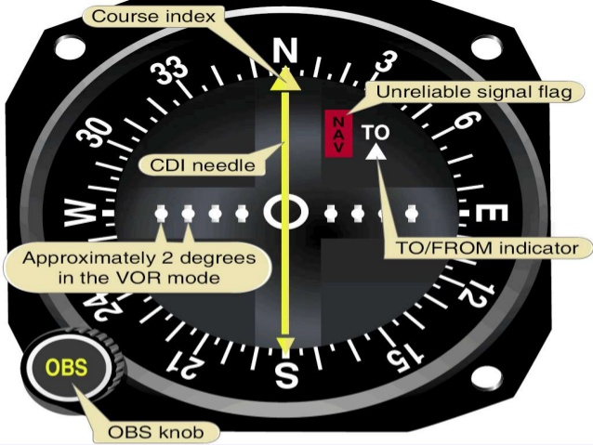
VHF omnirange system
Info from VOR receiver is displayed on CDI
The vertical needle is used as the course indicator.
Vertical needle also indicates when the aircraft deviated from the course.
The direction of the aircraft must be turned to attain the desired course.

Slide 36
Instrument landing system
Operates in the VHF portion of the electromagnetic spectrum.
System consists of a runway localizer, a glide slope signal, and marker beacons for position location.
Localizer equipment produces a radio course aligned with the center of an airport runway.
The on course signals result from the equal reception of two signals; blue sector (150 Hz) and yellow sector (90 Hz).

Slide 37
Distance measuring instrument
Constant visual indication of the distance the aircraft is from a ground station.
NOT a true indication of point to point distance as measured over the ground.
Indicates the slant range between the aircraft and the ground station.

Slide 38
Automatic direction finders
Radio receivers equipped with directional antennas.
Used to determine the direction from which signal are received
Provide controls for manual operation in addition to automatic direction finding
Operates in low and medium frequency spectra 190KHz through 1750KHz.

Slide 39
Doppler navigation system
Automatically and continuously computes and displays ground speed and drift angle of an aircraft without the aid of ground stations, wind estimates or true air speed data.
Does not sense direction as much as search radar does.
Uses continuously carrier wave transmission energy and determines the forward and lateral velocity component of the aircraft by utilizing the principle known as DOPPLER EFFECT.

Slide 40
Inertial navigation system
Self-contained system; does not require any signal inputs from ground navigational facilities.
Derives altitude, velocity and heading information from measurement of aircraft’s accelerations
Two accelerometers are required
The accelerometers are mounted on a gyro stabilized unit, called the stable platform
One reference towards east and other towards north.

Slide 41
Miscellaneous instruments
Accelerometer
Engine driven fuel pump
Break master cylinders
Emergency locator transmitter
Hydraulic propeller governors.

Slide 42
accelerometer
Accelerometer is an instrument that measures acceleration. It is used to monitor forces acting upon an airframe
The installation of accelerometers is usually limited to high performance and aerobatic aircraft.
Accelerometers are mechanical, direct reading instruments calibrated to indicate force in G’s.
One G is equal to one times the force of gravity.

Slide 43
accelerometer
Principle and working:
Accelerometer operates on the principle of inertia.
A mass, or weight, inside is free to slide along a shaft in response to the slightest acceleration force.
When maneuver creates an accelerating force, the aircraft and instrument move, but inertia causes the weight to stay at rest in space.
As the shaft slides through the weight, the relative position of the weight on the shaft changes. This position corresponds to the force experienced.
Through a series of pulleys, springs and shafts, the pointers are moved on the dial to indicate relative strength of acceleration force.

Slide 44
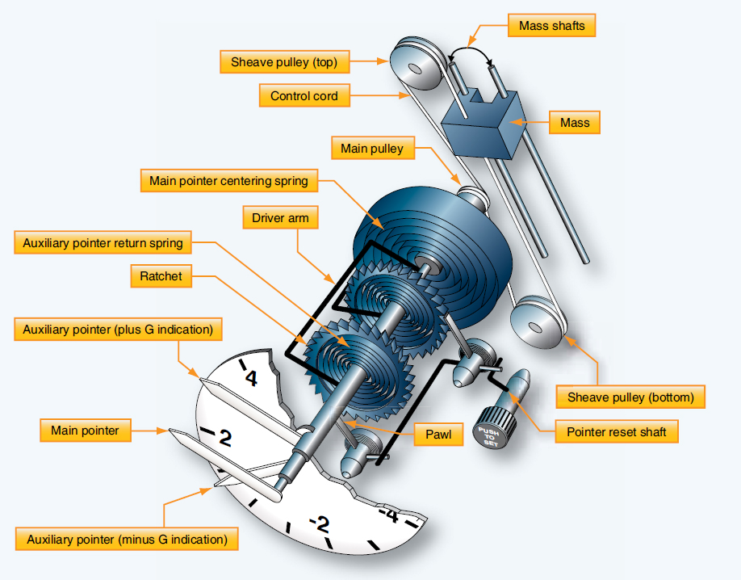

Slide 45
Engine driven fuel pump
Types of engine driven fuel pumps:
The gear type constant displacement fuel pumps, and
Piston type variable displacement fuel pumps.
Both pump types are positive displacement.
Engine driven fuel pump is located downstream of the electrically operated centrifugal type fuel boost pump.
Upstream of the pump is the fuel metering unit, the fuel flow meter, and the fuel nozzles.

Slide 46
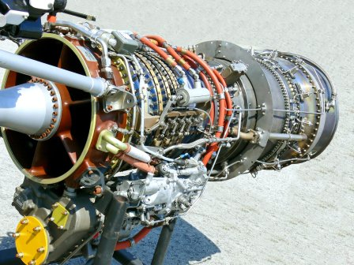
Engine driven fuel pump
Gear type constant displacement fuel pump has two stages, with the high pressure stage on the left and the low pressure stage on the right. With every rotation, the fuel pump delivers a continuous supply of fuel to engine.
Piston type variable displacement is the pump where displacement changes to meet fuel flow needs within the engine.

Slide 47
Break master cylinders
A master cylinder for each brake is mechanically connected to the corresponding rudder pedal.
When pedal is pressed, a piston inside a sealed fluid-filled chamber in the master cylinder forces hydraulic fluid through a line to the piston in the brake assembly.
The brake piston(s) push the brake linings against the brake rotor to create the friction that slows the wheel rotation.

Slide 48
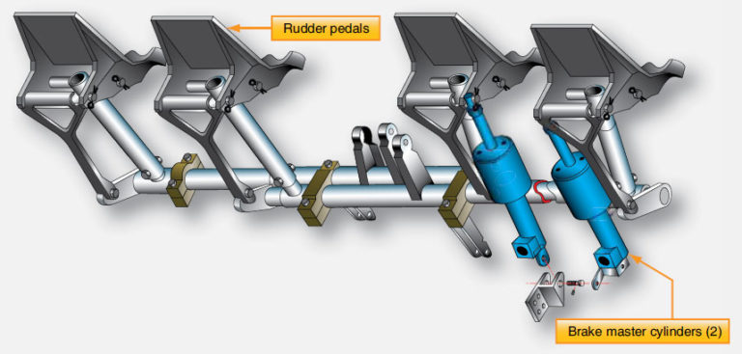
Break master cylinders

Slide 49
Emergency locator transmitter
ELT is a equipment which broadcasts distinctive signals on designated frequencies and, depending on application, may be automatically activated by impact.
An ELT may take any of the following forms:
Automatic fixed ELT: An automatically activated ELT which is permanently attached to an aircraft.
Automatic portable ELT : An automatically activated ELT which is rigidly attached to an aircraft but readily removed from the aircraft.
Automatic deployable ELT : An ELT which is rigidly attached to an aircraft and which is automatically deployed and activated by impact.
Survival ELT : An ELT which is removal from an aircraft, stowed so as to facilitate its ready use in an emergency and manually activated by survivors.

Slide 50
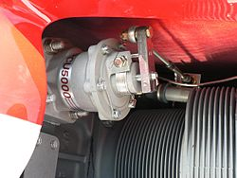
Hydraulic propeller governor
Constant speed propeller governors keep engine rpm constant by varying the propeller blade pitch.
Hydraulic governors accomplish this but controlling the flow of engine oil through hydraulic mechanisms in the propeller.

Slide 51
Thank You

